Slide 1

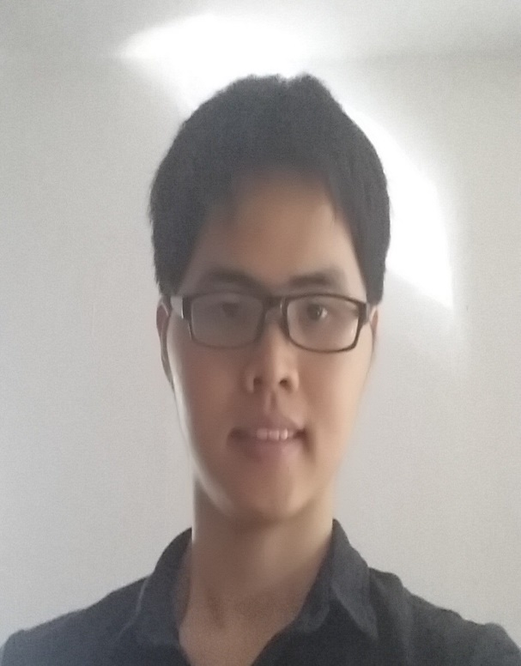



Riwu Julian Ruomu Shaun

Slide 2
7
How many objects can your mind hold in working memory?

Slide 3

Labour Day on
1 May
Meet Juliet tomorrow at 3pm
Submit sales report to boss by Fri
John’s wedding 15 May 8-10am
Gym session every 2 days 7-9pm
Safety briefing every Monday
Read War and Peace

Slide 4
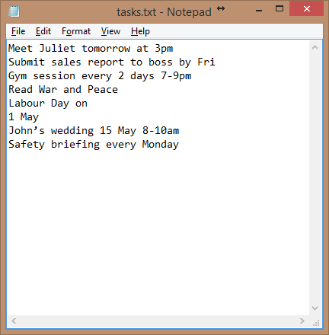

Slide 5
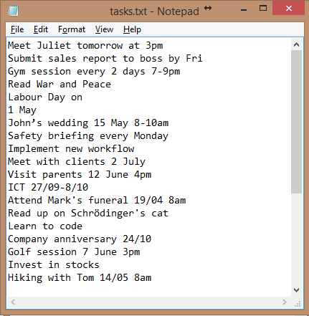

Slide 6
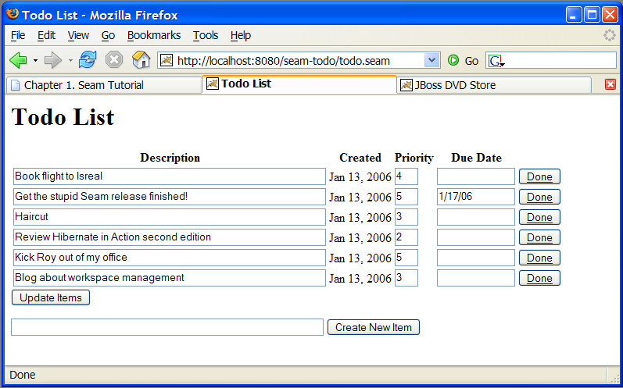
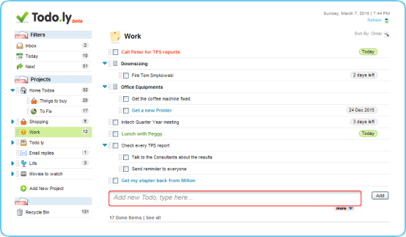
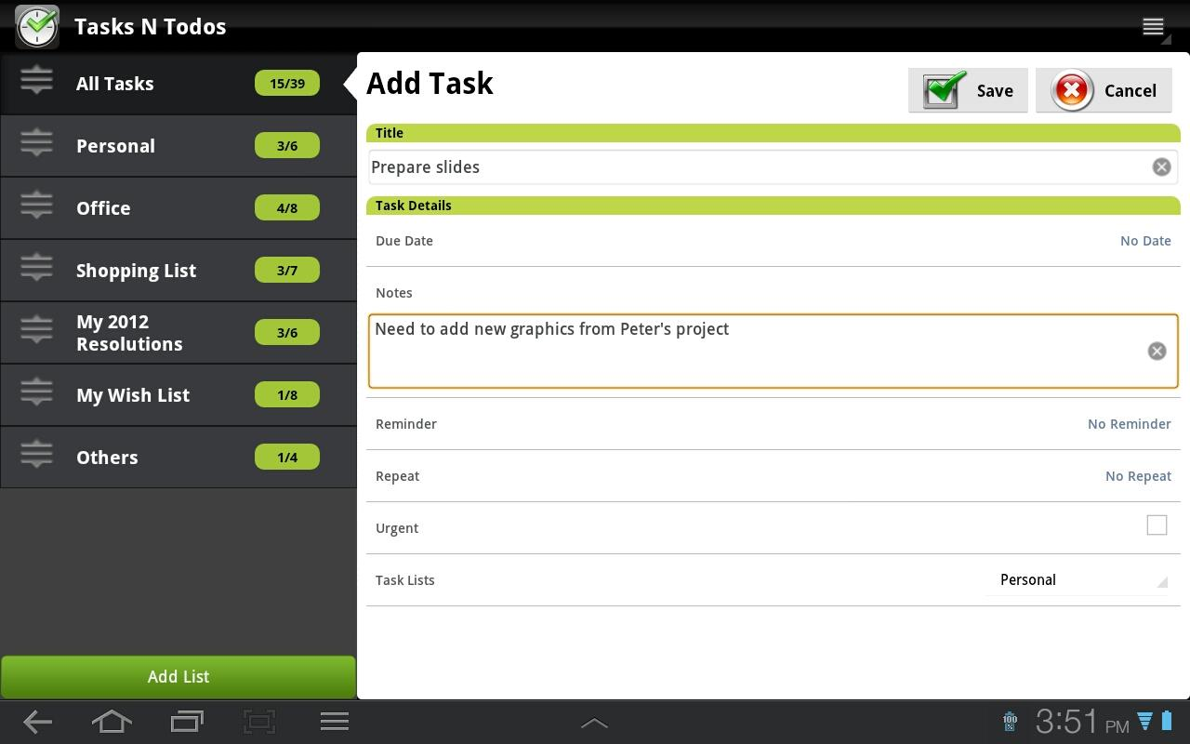
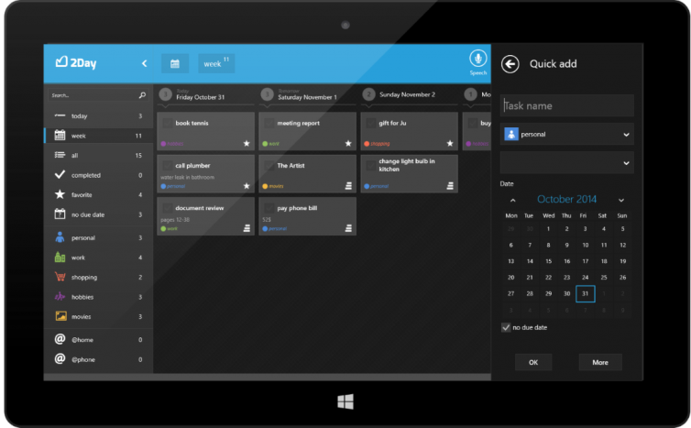
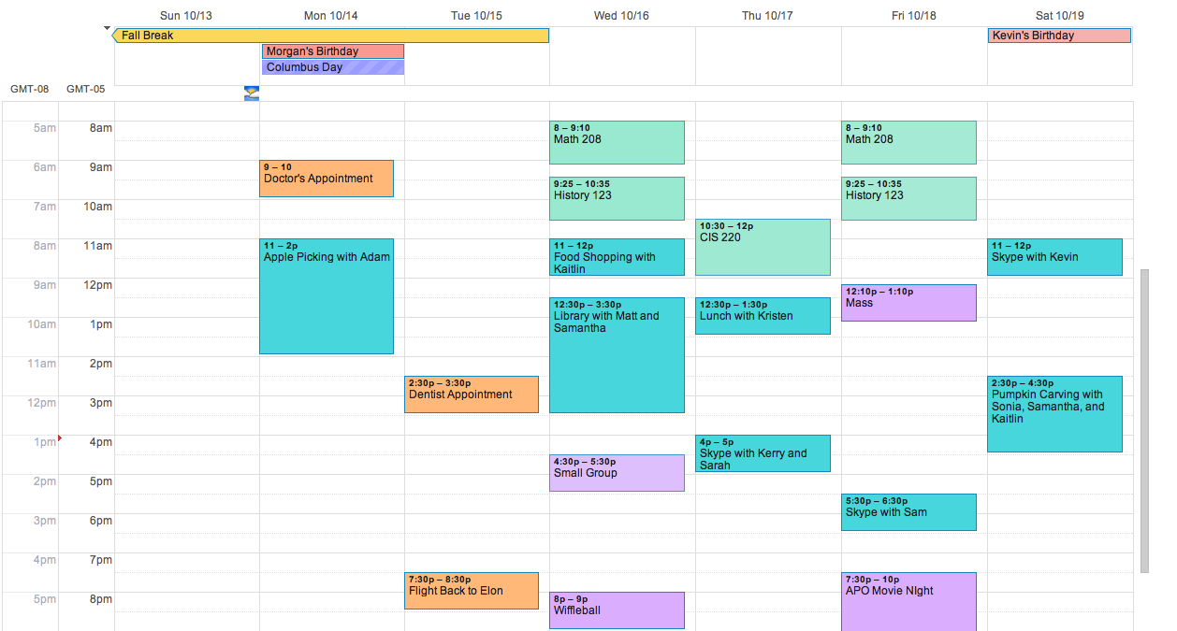

Slide 8
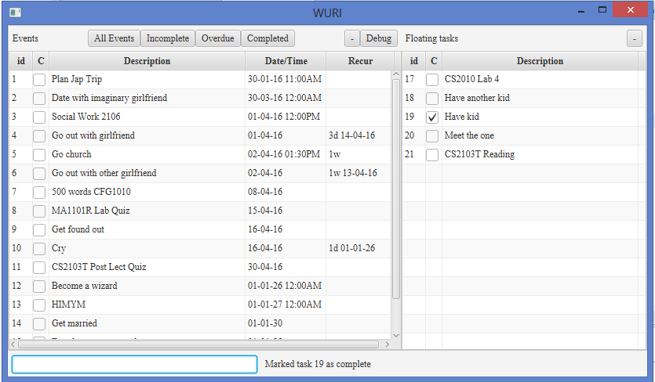
Notes:
Label components

Slide 9
Free and Open source
Safe and Virus-free
Continuously developed; never obsolete
Customisable by any programmer

Slide 10
Run on anything with Java
Download for free at www.java.com
Windows, Linux, Mac

Slide 11
Reliable
Task list saved to file after every operation.
Stable and never crashes

Slide 12
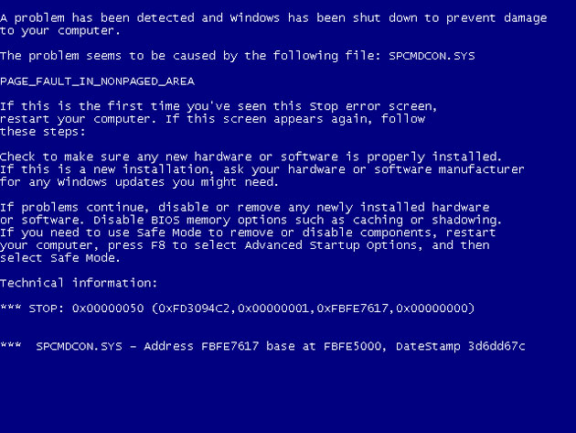

Slide 13
Performance
Saving done only after list updated on display
No perceivable delay

Slide 14
Ease of use
Only need keyboard
Minimal keywords
Single letter commands

Slide 15
Adding and Editing
Simple
Minimal effort
Notes:
Thank you Riwu and good afternoon everyone. I am Julian, and I will be bringing all of you through the add and edit capabilities of WURI. First off, WURI’s add feature is amazingly simple, built with the sole purpose of allowing users to add tasks with minimal effort. As showing will definitely bring more clarity than seeing, let us jump right into it!
Moving on, how many of us here have work due by the end of almost every week?
For me I often have work due by the midnight of Sunday. If you face a similar situation, no problem! Just type “Do work Sunday 23:59 1w” and WURI will now record this task every week on Sunday. If Sunday has passed and you want to move the deadline to the next weekend, simply type “d 1” to delete last Sunday’s task, bringing forth to the next week. I will leave Ruomu to discuss the rest of deletion later.
Now imagine if your meeting with your friend got rescheduled to Thursday instead. Simply type “e 1 thurs” and the date will be edited accordingly. Now what if your friend suddenly says that he can only make it for dinner as it is a weekday? Fret not! Type “e 1 7pm” and the new time will be reflected in WURI.
Lastly, imagine that your workload has increased and that you now have work due every 3 days! We totally understand that at this point, you do not have the time to fiddle around with fanciful commands, so we’ve kept it short and sweet. Simply type “e 2 3d” for your deadlines to now be set every 3 days! I will now be passing the time over to Ruomu to talk about the rest of WURI’s capabilities.

Slide 16
Adding – without deadlines
E.g.
“Read book”
“Listen to music”
“Watch a movie”
Notes:
Now, imagine that you want to read some books in your free time, at your own pace. You can simply type “Read books” into WURI for it to be recorded down for you!
Similarly, with any other tasks without deadlines, you can simply type them in to WURI as they are.

Slide 17
Adding – with date
E.g.
“Meet friend next Saturday”
“Overseas trip 30/4”
“Do everything tomorrow”
Notes:
Now, lets imagine that you are meeting a friend for lunch next Saturday. Simply type “Meet friend Saturday” to record it down into WURI.
Tada, isn’t it amazing?
Alternatively, you can also use a date to record a task in WURI or even key it down as today or tomorrow!

Slide 18
Adding – with time
E.g.
“Meeting 3pm”
“Run errands Sunday 1000-1200”
Notes:
Now, lets say that you want to record a specific time for a meeting that is going to be held today.
Simply type “Meeting 3pm” for it to be recorded into WURI, and it will be recorded right away for you.
Notice that time can also be entered together with a date,
For example, if you wish to block out 2 hours on Sunday morning to run errands, you can simply type “Run errands Sunday 1000-1200” and WURI will do the rest for you.

Slide 19
Adding – with recurrence
E.g.
“Do work Sunday 23:59 1w”
y=year, m=month, w = week, d = day,
Notes:
Moving on, how many of us here have work due by the end of almost every week?
For me I often have work due by the midnight of Sunday.
If you face a similar situation, no problem! Just type following this format, and WURI will now record this task every week on Sunday. Note that in this case 1w here stands for 1 week. Similarly, 2d stands for 2 days. If Sunday has passed and you want to move the deadline to the next weekend, simply type “d 1” to delete last Sunday’s task, bringing forth to the next week. I will leave Ruomu to discuss the rest of deletion later.
Additionally, you can also state an end date for a recurrence.
For example, imagine that you have signed up for weekly 10am Saturday yoga lessons until the end of May. You could simply type “Go for yoga lessons Sat 10am 1w 31/5” and WURI will record it down for you.

Slide 20
Editing
E.g.
“Do work Sunday 23:59 1w”
y=year, m=month, w = week, d = day,
Notes:
Moving on to editing, imagine if your meeting with your friend got rescheduled to Thursday instead. Simply type “e 1 thurs” and the date will be edited accordingly. Now what if your friend suddenly says that he can only make it for dinner as it is a weekday? Fret not! Type “e 1 7pm” and the new time will be reflected in WURI.
Lastly, imagine that your workload has increased and that you now have work due every 3 days! We totally understand that at this point, you do not have the time to fiddle around with fanciful commands, so we’ve kept it short and sweet. Simply type “e 2 3d” for your deadlines to now be set every 3 days! The commands used in editing are very similar to the commands for adding, in order to lessen the time you have to take to learn our intuitive commands. I will now be passing the time over to Ruomu to talk about the rest of WURI’s capabilities.

Slide 21
Mark as complete
E.g.
“c 15” – mark/demark the task with ID 15
Notes:
Thank you Julian, I will continue with Julian’s demonstration and show you how powerful WURI is. As a todo list software, WU.RI will definitely allow you to mark a event as complete. For example, Zootopia is on show now. Let’s assume you have just watched this movie, then you could type c 8 to mark the “watch a movie” task as completed. After watching the movie, you want to go kinokuniya to find some book to read, then you may want to use “t 10” to mark the “Read books” as complete. Then basically this is everything you want to do today, so you also use “c 2” to complete the “Do everything”. Now, on WURI you can see you have completed 3 tasks today~~~ Congrats~~~ But what if you suddenly decided that you need to listen to a concert today also. Then you can use the same command “c 2” to remark the “do everything” as incomplete again. In summary, if you want to mark certain task as complete/incomplete, just type in c + the id of the task.

Slide 22
Delete
E.g.
“d 2” – Delete the task with id 2
“d <11/4/16” – Delete all the tasks before 11/4
“d + id + r” for deleting recurring tasks
Notes:
After all, the “do everything” is a bit vague. You, as a perfectionist, do not want to see such ambiguous task. You may find the Deletion function useful. You can do deletion in many ways as you wish. You may want to use “d 2”, which means “delete task with id 2” to delete the “Do Everything” task. With WURI, you are efficient in your work, say you have finished all the tasks before the 10th of April, you can use “d <11/4” to delete all the tasks before 10th .

Slide 23
Undo
“u” – stands for “undo”
Notes:
WURI also allows you to revert you operations. Just now you have removed all the tasks before the 10th , but suddenly you become unsure about whether you have really completed all the tasks before that date. You want to make sure. So you can use the undo function provided by WURI, you type in a u, then just enter it. See, all the tasks you have just deleted come back. Looking at those tasks, you realize that you have indeed finished them, very good, we can delete them again.

Slide 24
find
E.g.
“f Alice” to find all the tasks related to Alice
“f” to display all tasks
Notes:
With so many tasks to do every day, you may need to search among all your tasks to find the one you need to do now. To demonstrate the find function, please allow me to input some data first. … Ok, now we have a lot of meetings here. We want to know when am I going to meet Alice, since I need to prepare some gift to her before I can go. You need not to eye power through all the tasks to locate the task with Alice, you can just type in “f Alice” to find all event related to Alice and then you can plan your work accordingly.

Slide 25
No need to remember commands!
Always feel free to use “h” or F1 to call up the help window
Notes:
So many commands? No worry, you can always use h or F1 to call up the help window to find the command you need!

Slide 26
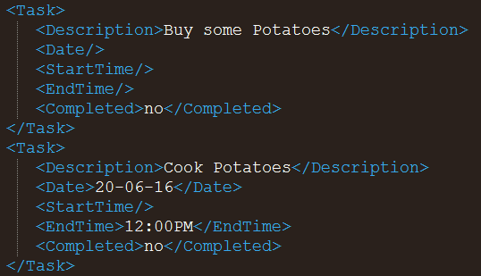
Storage
Extensible Markup Language (XML)
Simple structure
Easy to edit

Slide 27



Storage

Slide 28

What’s next?
Colour scheme
Change Fonts
Mobile App
Notifications
Modular
Encryption
Web App
Scalable
Autocomplete
More

Slide 29

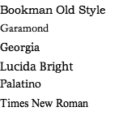
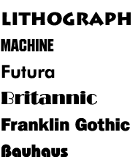
What’s next?
Customizability
Colour scheme
Font

Slide 30

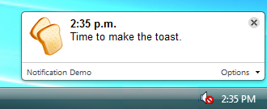




What’s next?
Notifications
Encryption

Slide 31
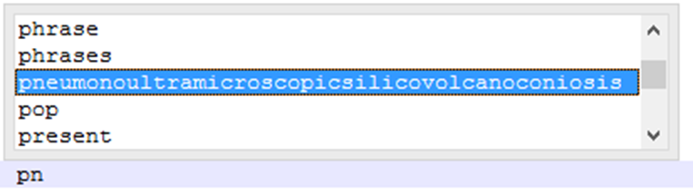
What’s next?
Autocomplete & Autocorrect
Personalized

Slide 32
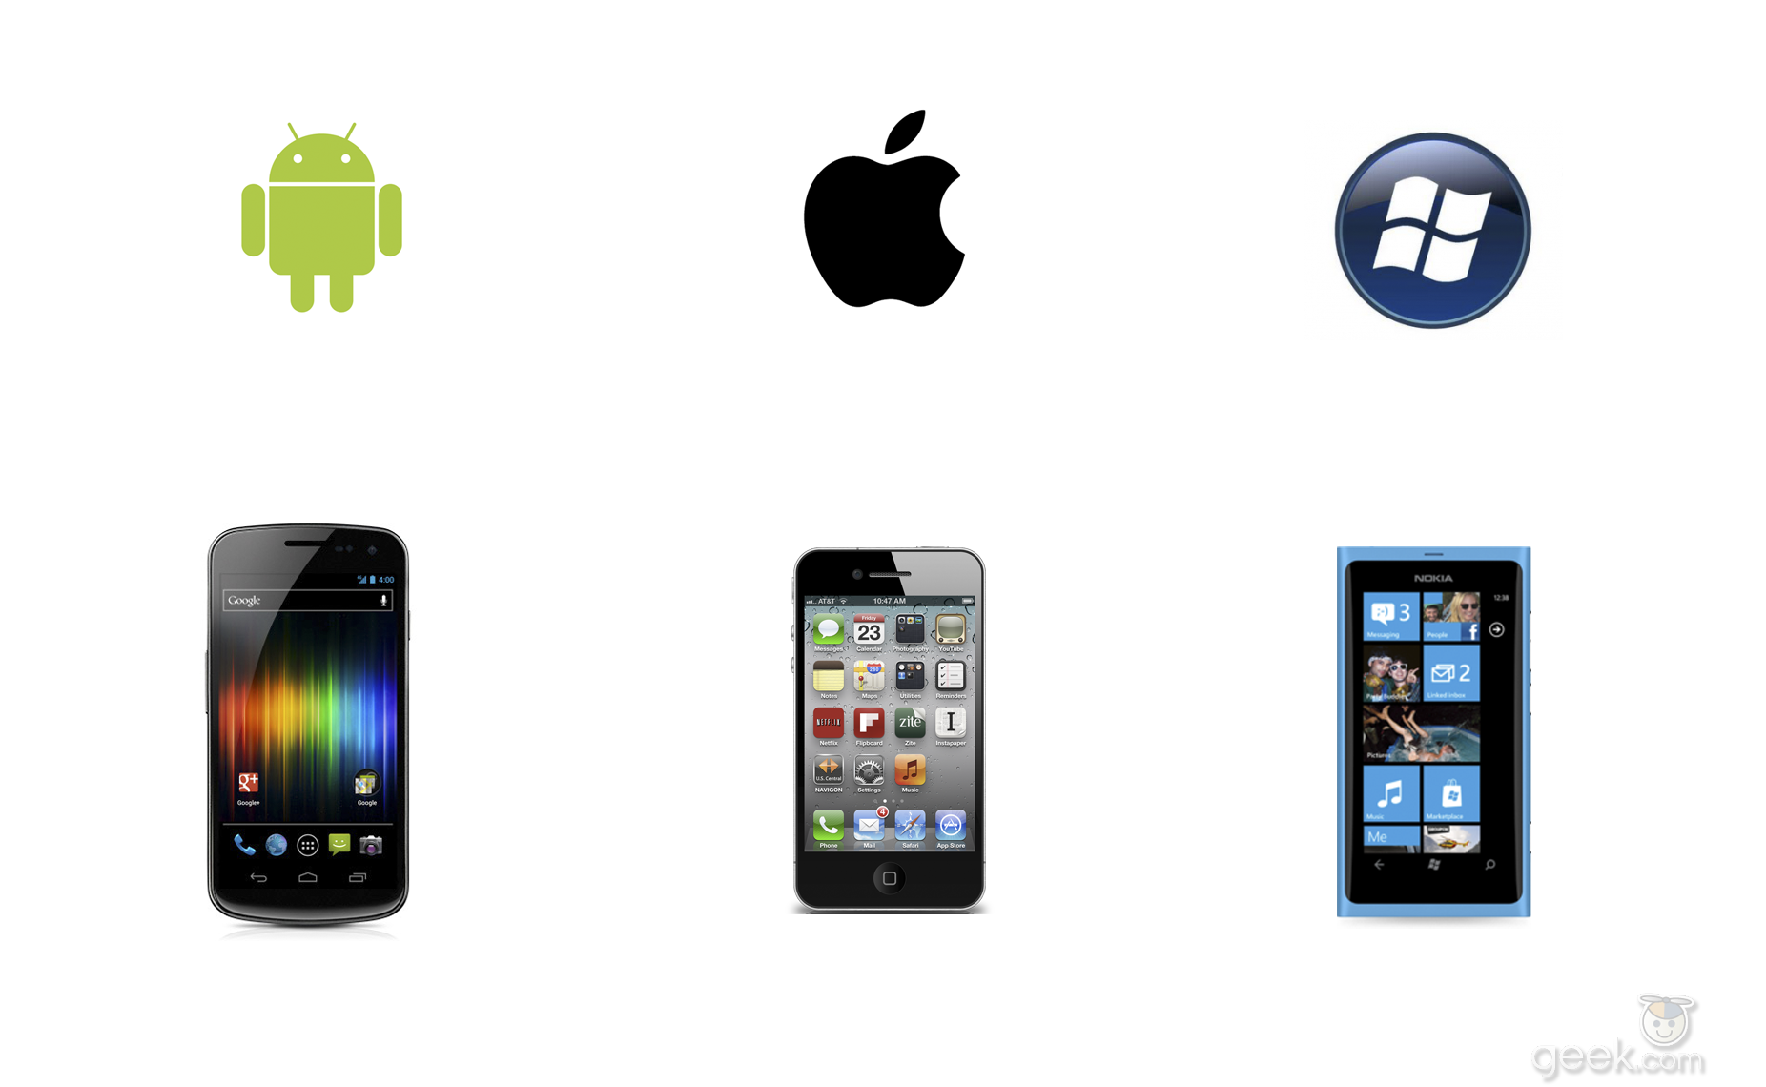

What’s next?
Mobile support
Web Application

Slide 33
Questions?

